Slide 1
Aligning curriculum and instruction
Michele Westphal
Instructional Services
STEM Consultant
Lancaster-Lebanon IU 13

Slide 2
Essential Questions
What is curriculum?
Why do we need to have a written curriculum?
What are the resources and tools available on the SAS Portal to support curriculum alignment and student achievement?

Slide 3
Please Consider…
Do we need a system of common written curriculum and common assessments that all teachers use with consistency? Why or why not?
Notes:
Take a couple of minutes and individually write down a few thoughts that you have pertaining to this comment. We will revisit your thoughts at the end of the session.

Slide 4
We work in transitional times!
PA Core Standards in Math and ELA
Standards Aligned System
Keystone Exams and new Math and ELA PSSAs
Educator Effectiveness
SLOs
Teacher Specific Reporting

Slide 5
But Alignment is Not New!
You already have some form of curriculum.
You already provide instruction.
You already assess your students.
You already attend to effective classroom management.
The question is . . .
How do we do these even better?

Slide 6
Examine the Evidence
Dr. Robert Marzano: What Works in Schools
School and Teacher Scenario | Achievement Percentile After Two Years
Average school and average teacher | 50th
Least effective school and least effective teacher | 3rd
Most effective school and least effective teacher | 37th
Least effective school and most effective teacher | 63rd
Most effective school and most effective teacher | 96th
Most effective school and average teacher | 78th

Slide 7
The Purpose for Curriculum in Schools
FOCUS - to identify what is essential and significant – beyond state and national standards
CONNECT - to reinforce complex learning leading to mastery within and across grade levels and schools
EQUITY - to ensure that every student has access to the curriculum because it is their right

Slide 8
RATIONALE for Deep Curriculum Alignment
The primary objective for deep curriculum alignment is to change the opportunity structure (OS), that consistently favors a certain cultural subset of students in schools. By changing the OS, a level playing field is created so that all children can succeed- and the fault lines of race, gender, and socio-economic status (SES) levels are eroded or erased as predictors of achievement.

Slide 9
Components
Curriculum
Instruction Assessment
Curriculum – The Plan for the Work
Instruction – The Work
Assessment – The Measure of the Work

Slide 10
Alignment of the Components
Written
Taught
Assessed
Curriculum = Written Curriculum = The Plan for the Work
Instruction = Taught Curriculum = The Work
Assessment = Assessed Curriculum = The Measure of the Work
Notes:
The three components of a curricular program are the written curriculum, the taught curriculum, and the assessed curriculum.
The written curriculum is the plan for the work (the work of teaching and learning). It is sometimes just referred to as the curriculum.
The taught curriculum is the actual work. It is the most important component – the act of actual teaching and learning. Often referred to as instruction.
The assessed curriculum is the measure of the work. It is how you know if the first two components were successful. Typically it is called assessment.

Slide 11
What is the Current State of Alignment?
Written
Taught
Assessed
Written
Taught
Assessed
Written
Assessed
Taught

Slide 12
Ideal Curriculum Alignment
Taught
Written
Assessed
Notes:
The three components of a comprehensive curricular program need to be aligned, one within the next. In many cases, the written, taught, and assessed curriculum only overlap each other just slightly, if at all. In a deeply aligned curricular program, the components do more than overlap, that fit one within the next.
The largest of the three circles, the taught curriculum, represents 100% of the curricular program. Teachers are with students day in and day out and provide instruction for 100% of the time available for teaching and learning.
The medium size circle that is completely contained within the taught circle is the written curriculum. While not to scale, this represents the district curricular design that all teachers must teach with a degree of fidelity to ensure that all students in Lower Merion receive a consistent education. Ideally, the written curriculum only represents about 80% of the time available for teaching and learning. The other 20% of the taught curriculum is up to the trained professional educator to decide as he/she considers the needs and interests of his/her students.
The small circle that is contained within the written curriculum circle, which is contained within the taught curriculum circle is the assessed curriculum. Again, while not to scale, this represents the district assessment system that all teachers must implement with a high degree of consistency and security. Not every single concept or skill that is a part of the written curriculum is assessed in a formal or summative way. While all teaching and learning should be assessed, it is often in the form of more informal, day-to-day formative assessments. This small circle represents summative assessments such as end-of-unit assessments, mid-terms, and finals. Not everything that is taught to students is assessed because many concepts and skills are only being taught for the first time. Mastery should not be expected the very first time that something is taught. Students should have multiple and varied learning experiences with any particular concept or skill before it is assessed on an summative assessment where it counts for a grade.
Deciding what to teach and what to assess requires careful planning and collaboration.

Slide 13
WITHOUT ALIGNMENT…
Student and community demographics will continue to be the largest predictors of student achievement.
--Edward L. Thorndike

Slide 14
WITHOUT ALIGNMENT…
…FOUR VARIABLES WILL PREDICT STUDENT ACHIEVEMENT
Education of the parents
Number of parents at home
Type of community
Poverty rate
- CULTURAL CAPITAL -
From Robinson & Brandon (1994)

Slide 15
CULTURAL CAPITAL
Cultural capital refers to the uneven distribution of selected cultural content and linguistic patterns/ vocabulary which identify social classes in the nation
Cultural capital is an expression of the education level of the parents
Schools “center” or value some cultural capital while de-center or marginalize others
Children with little of the cultural capital of the cultural elite are sometimes penalized for their differences, and may even be incorrectly identified as less able

Slide 16
Cultural Capital and Tests
Tests embrace certain cultural capital as being more important to assess than others
Test content typically reflects the values and interests of the cultural elites who prize the content in which they are experts
Tests posture as “neutral” tools, which assess “objective knowledge” when they are congruent with values and content of those social classes in control of society
Tests reinforce cultural control of the curriculum of those currently holding the power – the cultural elite
Socio-economic status is a potent predictor of test performance on unaligned tests because tests are not “neutral” of the social class structure

Slide 17
RATIONALE for Deep Curriculum Alignment
The primary objective for deep curriculum alignment is to change the opportunity structure (OS), that consistently favors a certain cultural subset of students in schools. By changing the OS, a level playing field is created so that all children can succeed- and the fault lines of race, gender, and socio-economic status (SES) levels are eroded or erased as predictors of achievement.
Notes:
Come back to this again because it is so powerful!

Slide 18
Four Essential Questions
DESIGN: Do we have it?
ANALYSIS: Is it any good?
DELIVERY: Are we using it?
SO WHAT: Did it make a difference?

Slide 19
The 100 - 80 Rule
All teachers must teach 100% of the “Official” Written Curriculum.
The “Official” Written Curriculum must not represent more than 80% of the instructional time!

Slide 20
Three Dimensions of Alignment
CONTENT: The topics and concepts included in the written curriculum, instruction, and assessments. (Examples: Cells, addition)
CONTEXT: The situation or format that is used as the means to provide the content. (Examples: Simulations, real world, online)
COGNITIVE TYPE: The type of mental processes required to learn the topics and concepts and demonstrate understanding (Examples: Bloom’s Taxonomy, Webb’s Depth of Knowledge)
Notes:
When developing written curriculum and assessed curriculum, there are three dimensions to consider: content, context, and cognitive type.
Content is what most educators think about when designing an aligned written curriculum. They look at the standards, identify the content knowledge and skills, and write a curriculum that “covers” the concepts and topics.
Context takes alignment one step further. When designing a deeply aligned curriculum, the context of the standards must be included in the curricular design. For example, if the standards refer to a lab experience for learning about a particular science concept, then that must be a part of the curricular design in order to achieve alignment. Context also refers to situations, locations, and specific examples. If the standards provide an example in parentheses, then that example should be included in students’ learning experiences. The same holds true for assessment design. If the one context was used to provide instruction, the same context should be used for assessing learning. A different context on an assessment is actually assessing the cognitive ability to transfer and apply learning, and unless that is the skill that you are deliberately teaching, it is not what you should be assessing. From a standardized testing perspective, educators must be aware of the contexts of exams such as the PSSA’s and Keystones. The context is included in documents such as Assessment Anchors and Eligible Content. The examples in parentheses should be intentionally embedded in district written curriculum and assessed curriculum.
Cognitive type is the final dimension of alignment. If written curriculum is only aligned to topics, but not to the level or depth of understanding represented in the Academic Standards or assessed on high-stakes tests like PSSA’s, then students were inadequately prepared to meet the standards. Alignment involves figuring out to what level of depth, or to what degree a student is expected to learn, understand, and demonstrate understanding of concepts and abilities.

Slide 21
Two Levels of Alignment
TOPOLOGICAL (Surface)
A generic “match” between curriculum, instruction, and assessment content with some sequencing considerations.
A generic “match” in context – the test format is embedded in classroom situations through methods such as “test review” and “test prep.”
DEEP
Congruence of curriculum, instruction, and assessment is achieved through intentional alignment content, context, and cognitive type.
Students have maximum familiarity with the content, context, and cognitive type, which ensures the highest degree of transfer.

Slide 22
Articulation
Idiosyncratic | Upward Alignment | Articulated & Coordinated
11 10 12 9 8 7 6 5 4 3 2 1 K |  | Do not confuse this with a spiraling curriculum.
Notes:
Articulation
Alignment of curriculum across grades and courses
Coordination
Alignment of curriculum across schools and classrooms

Slide 23
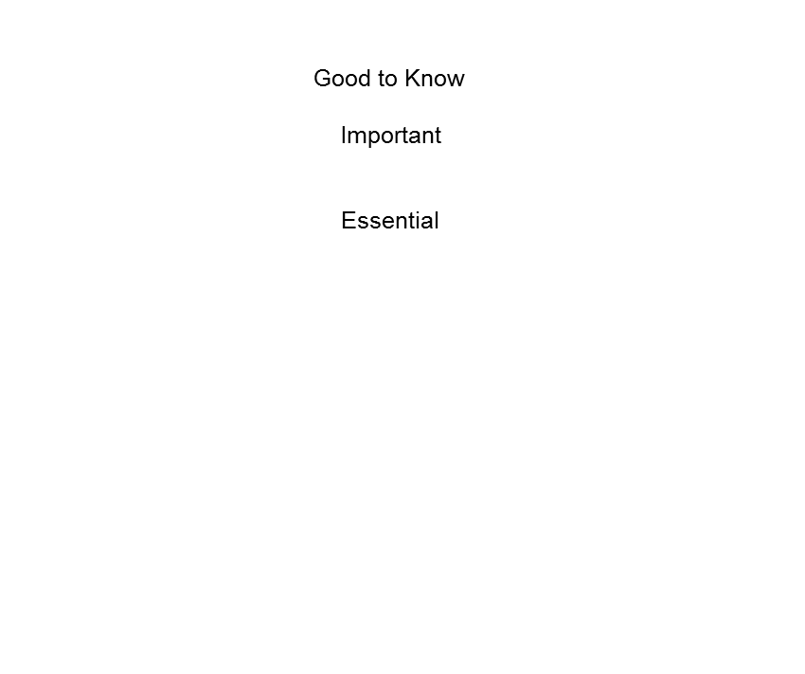
Deciding What’s Important & Essential
Good to Know
Important
Essential
Notes:
We tend to think about a traditional Bull’s Eye approach.

Slide 24
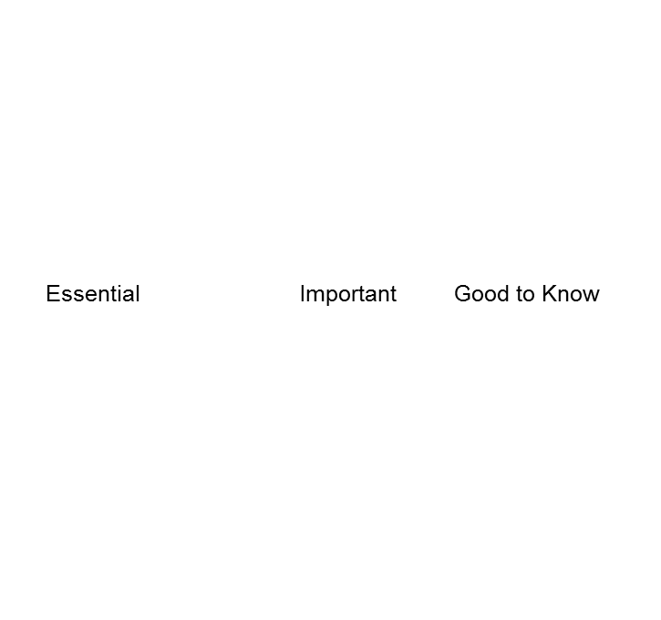
Deciding What’s Important & Essential
Essential Important Good to Know
Notes:
50% = Essential
20% = Important
10% = Good to Know
20% = Unplanned

Slide 25
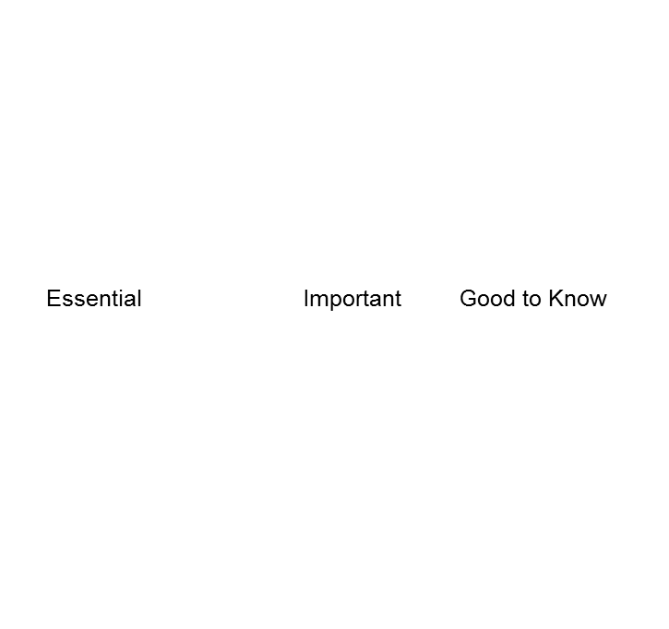
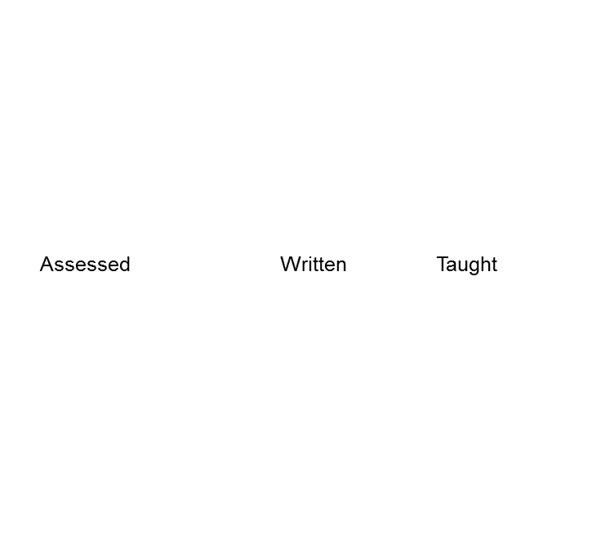
Deciding What’s Important & Essential
Essential Important Good to Know
Assessed Written Taught
Notes:
Work on Bull’s Eye Activity now by selecting one subject or course that you teach.

Slide 26
BREAK TIME

Slide 27
Much research has been conducted as to what makes a great school. There are many intangible components. However, research supports the notion that great schools and school systems tend to have six common elements:
Standards
Assessments
Curriculum Framework
Instruction
Materials and Resources
Safe and Supportive Schools
Notes:
The Pennsylvania’s Standards Aligned System (SAS) is a:
Collaborative product of research and good practice
Identifies six distinct elements which, if utilized together, will provide school and districts with a common framework for continuous school and district improvement

Slide 28
SAS: Standards Aligned System
The Pennsylvania Standards Aligned System (SAS) is a collaborative product of research and good practice that identifies six distinct elements which, if utilized together, will provide schools and districts a common framework for continuous school and district enhancement and improvement.

Slide 29
What are standards?
Describe what students should know and be able to do
Increase in complexity and sophistication
2 places to view standards depending on what you teach

Slide 30
Overview of CCSS Initiative
State-led and developed
Informed by best available evidence and research
Reflect aspirations of our children and realities of the classroom
Benchmarked to international standards
Ensures students competitive in emerging global marketplace
Notes:
The Common Core State Standards Initiative is a state-led effort to establish a shared set of clear educational standards for English language arts and mathematics that states can voluntarily adopt.
Federal government was not involved.
States voluntarily adopted these standards.
The standards have been informed by the best available evidence and the highest state standards across the country and globe and designed by a diverse group of teachers, experts, parents, and school administrators, so they reflect both our aspirations for our children and the realities of the classroom.
These standards are designed to ensure that students graduating from high school are prepared to go to college or enter the workforce and that parents, teachers, and students have a clear understanding of what is expected of them.
The standards are benchmarked to international standards to guarantee that our students are competitive in the emerging global marketplace.

Slide 31
On July 1, 2010
Pennsylvania State Board of Education adopted the CCSS for
ELA
Mathematics
At that time, 18th state to do so
Unanimous vote
Followed six months of careful study

Slide 32
Transitioning to the PA Core Standards

Slide 33
October 2011
Revised Anchors and Eligible Content in Math and Reading in grades 3-8, 11
KEEPING same rigor and content

Slide 34
January 2012
Revised PA Academic Standards in Reading and Math
Created set of PA Common Core Standards
Begin development of Common Core aligned PSSA Reading and Math tests

Slide 35
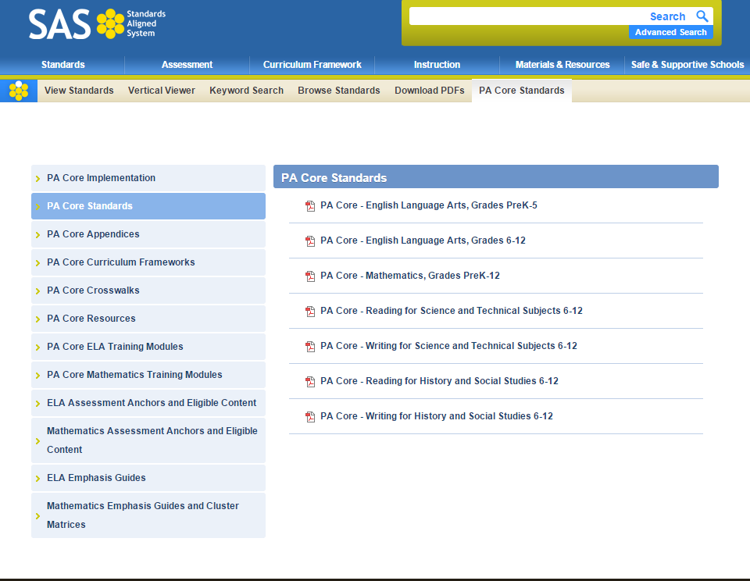
March 2014
PA Core Standards in ELA and Math officially in place as regulation

Slide 36
Features of the PA Core Standards
Fewer and deeper
Aligned with college and work expectations
Focused and coherent
Rigorous content and application of higher-order skills
Build upon strengths and lessons of current state standards
Emphasize design and delivery of instruction that engages students
Research based
Notes:
PA Core Standards represent a real shift in instructional intent from high school completion to college-and-career readiness for every student.
PA Core Standards require students to demonstrate mastery of content, which cannot be acquired solely through lecture. Provide
professional growth opportunities emphasizing the design and delivery of instruction that engages students in learning as well as provides you with the “look fors” when observing instruction.
PA Core Standards emphasize application and higher-order thinking skills. Can you recognize high-order thinking skills when observing instruction? Assess your professional growth needs in order to lead your teachers through the implementation of the instructional shifts and the rigorous demands of the PA Core Standards; then, develop a plan to address the needs.
• PA Core Standards at each grade may cover fewer topics; yet, content is taught in much greater depth. Monitor curriculum and instruction to assure the content is taught at the depth required by PA Core Standards.

Slide 37
PA Core Standards Shifts
ELA/LITERACY | MATHEMATICS
1. Building knowledge through content-rich nonfiction. | 1. Focus strongly where the Standards focus.
2. Reading, writing and speaking grounded in evidence from text, both literary and informational text. | 2. Coherence: Think across grades, and link to major topics within grades.
3. Regular practice with complex text and its academic language. | 3. Rigor: In major topics pursue conceptual understanding, procedural skill and fluency, and application with equal intensity.

Slide 38
PA Core Documents Available
STANDARDS TAB
PA CORE STANDARDS TAB
Crosswalks
Resources
Eligible Content
Emphasis Guides

Slide 39
Curriculum framework

Slide 40
Curriculum Framework
What is being taught?
Includes:
Big Ideas
Concepts
Competencies
Essential Questions
Separate documents for PA Core or PA Academic Standards

Slide 41
Big Ideas
UNDERSTAND
Declarative statements that describe concepts that transcend grade levels.
Essential to provide focus on specific content for all students.

Slide 42
Concepts
WHAT
Key knowledge as result of instruction specific to grade level

Slide 43
Competencies
DO
Key skills as a result of the instruction, specific to grade level.

Slide 44
Essential Questions
Frame student inquiry
Promote critical thinking
Assist in learning transfer

Slide 45
Curriculum Framework
Concepts = Know
Big Ideas = Understand
Competencies = Do

Slide 46
Activity: Sas Standards and Curriculum search

Slide 47
3-2-1 Summary
Please write responses to the following:
3 – Things that you have learned today
2 – Concepts that must be considered when writing curriculum
1 – Question that you still have about curriculum and standards alignment

Slide 48
Additional Information:
Michele Westphal
Instructional Services
Lancaster-Lebanon IU 13
michele_westphal@iu13.org

